Slide 1
PI Project
By: Florish Oluyemi

Slide 2
Data Profile - Video Games
Title | Release Date | Rating | Times Listed | Number of Reviews
Elden Ring | 2/25/2022 | 4.5/5 | 3900 | 3900
Hades | 12/10/2019 | 4.3/5 | 2900 | 2900
Undertale | 9/15/2015 | 4.2/5 | 3500 | 3500
Hollow Knight | 2/24/2017 | 4.4/5 | 3000 | 3000

Slide 3
General Questions
Do games connected to a big series sell more than others?.
Is there a correlation between high rating and a high wishlist amount?
Do longer summaries correlate with higher ratings?

Slide 4
Audience + Communication Goal
Audience: The intended demographic is video game customers of all demographics.
Communication Goal: The communication goal for this project is to understand to correlation between different aspects of gaming statistics to gain insights that may lead to higher buyer satisfaction.

Slide 5
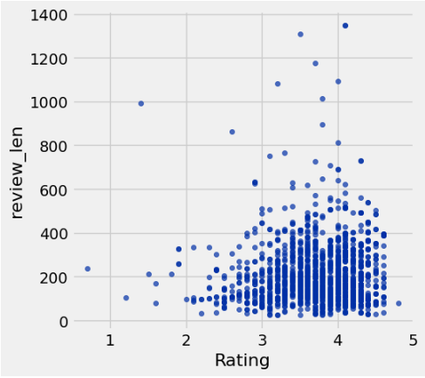
Insight #1 - Do games with longer reviews correlate with higher ratings?
Ratings seem to have no strong correlation with the length of reviews.
Games of similar ratings span all level of review lengths
Most long reviews are for highly reviewed games, and vice versa.
This graph indicates that review length does not indicate game quality, majority of the time.

Slide 6
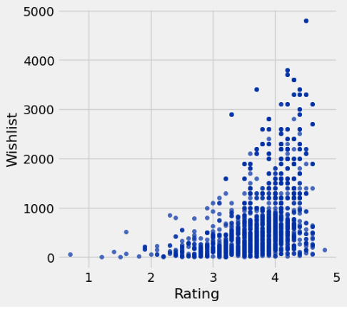
Insight #2 - Is there a correlation between high rating and high wishlist amount?
There is a strong correlation between the quality of a game and the amount of wishlist saves it has.
This indicates that high rated games may generate more buzz and conversation around them leading others to wish to buy it.

Slide 7
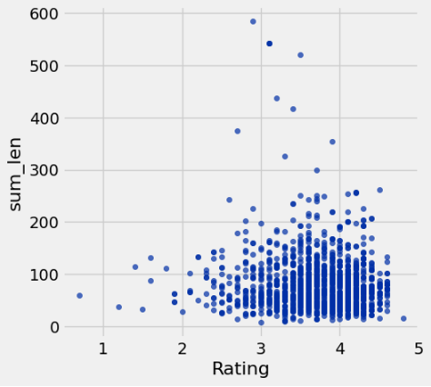
Insight #3 - Do longer summaries equate to higher reviews?
There is no strong correlation between rating and summary length. The correlation here is much less concrete than in insight #1 referring to review length. This most likely is because this is less about customer opinion and more about what the objective description of the game is.
This could also indicate that game depth or complexity does not have any impact on customer satisfaction.

Slide 8
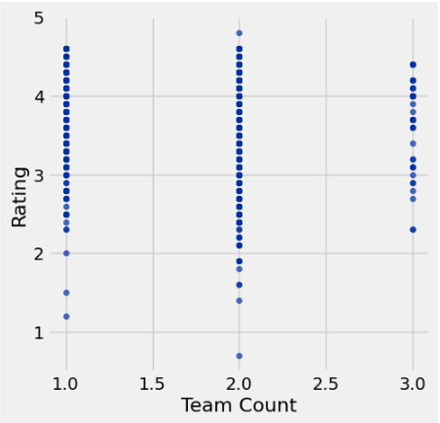
Insight #4 - Do games with bigger teams behind them get higher ratings?
There seems to be no strong correlation between the size of teams and the rating the game obtains. All 3 standard team sizes obtain a wide range of ratings. Although 3 has the lowest sample size, it does have the highest average rating
This graph indicates that team size does not generally matter for game quality.

Slide 9
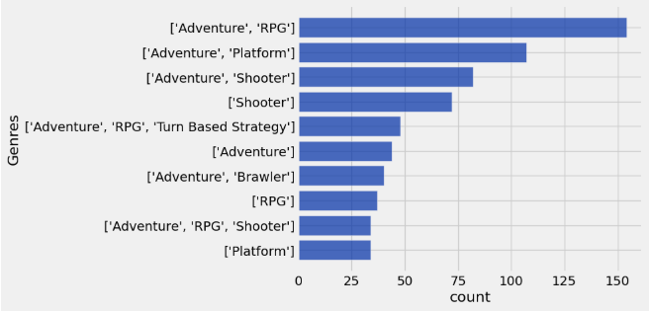
Insight #5 - What is the most common genre?
The most common genre combination is Adventure/RPG by a significant margin, then followed by Adventure/Platform and Adventure/Shooter. Adventure as a base genre appears consistently across nearly all top combinations, suggesting it is the dominant genre in the dataset. Pure single-genre games like just 'Shooter' or 'Adventure' alone still rank in the top 10, but most games tend to blend multiple genres together.
This graph indicates that Adventure is the backbone genre of the dataset, and developers rarely release games under a single genre label.

Slide 10
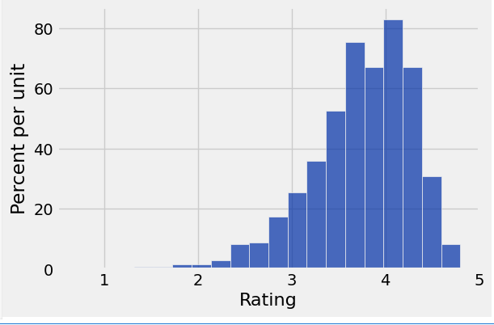
Insight #6 - How spread out are data scores? Are some scores rarer than others?
A vast majority of video game ratings are concentrated between ~3.3+ to the 4 range. The number of ratings seem to strongly taper off when getting closer to the ~4.7 range or higher. The same can be sad for the inverse as it approaches the 3 rating range.
This suggest that most users are happy with their purchases and very little have strong regrets.

Slide 11
Week 4
This week I researched how the release date of video games may affect different aspects of the user experience.
Technology is constantly changing and evolving and this extends to technological entertainment as well. My focus with this week was to understand if these advancements have changed the way users interact with games.
To investigate this, I analyzed several metrics across time using release year as my primary variable. Specifically, I looked at whether average game ratings have shifted over the decades, whether review lengths have grown as gaming communities became more vocal, whether games have expanded in scope by incorporating more genres, and how engagement metrics like plays, wish lists, and backlogs have trended over the years.
Together, these four insights aim to paint a picture of how the relationship between games and their players has changed over time, not just in terms of quality, but in terms of depth of engagement and community involvement

Slide 12
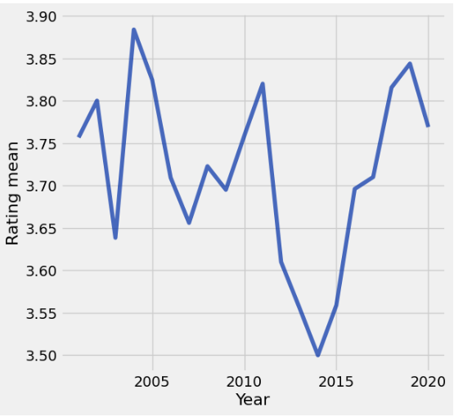
Insight #7 - Has the average game rating changed over the years?
I set the dataset from 2001-20021, because of the short list of games outside those years leading to misleading ratings.
The average game rating has been largely unstable. Since 2001, game ratings have seen as high as a ~3.9/5 average rating and as low as 3.5/5 average rating.
This indicates that time may not have much effect on the quality or enjoyment level of games.

Slide 13
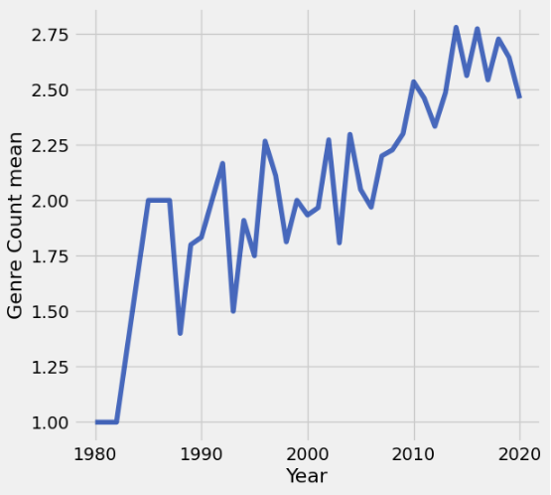
Insight #8 - Have games been getting more genres added to them over the years?
Genre count has steadily rose over the years. The amount of games released in each year may skew the mean but the graph still shows strong overall growth across all time periods.
Though overall growth is positive, it’s not very steady seeing consistent drops as the graph moves over time.
We can infer from this increase that as time passes more genres are explored and more games opt to mix and add these genres.

Slide 14
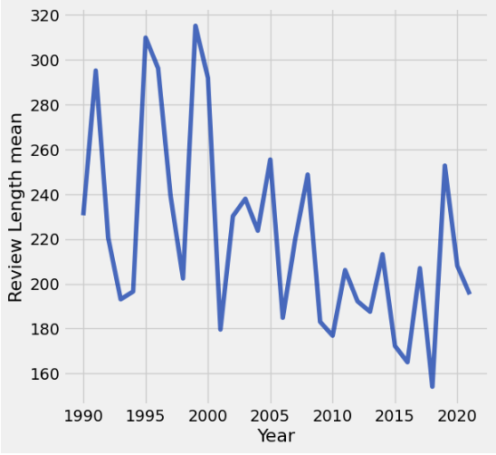
Insight #9 - Has the length of reviews increased over the years?
The graph shows no strong upward or downward trend in review length over time. Review lengths fluctuate consistently between roughly 160-320 words across all years, with no clear direction.
The most notable spikes appear in the early 1990s and around 2000, but these may be due to fewer games being released those years, skewing the mean upward.
This indicates that despite gaming communities growing significantly over time, the depth at which individual users write about games has remained largely the same.

Slide 15
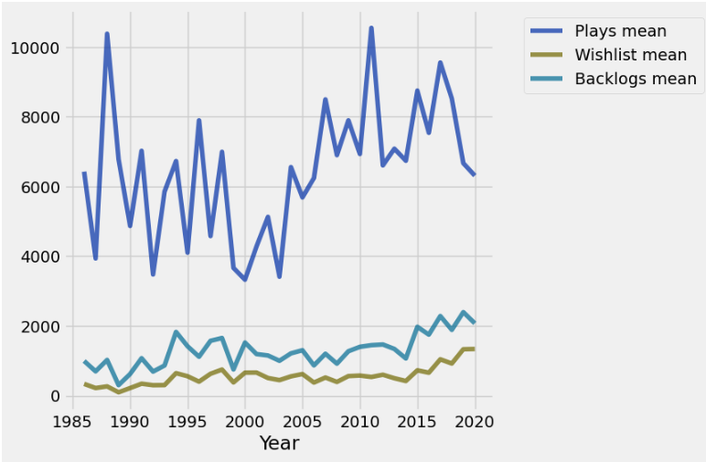
Insight #10 - How have plays, wish lists, and backlogs changed over the years?
Plays mean has seen consistent overall growth since the mid 1980s, peaking around 2010-2011 before slightly declining. Wishlist and Backlogs mean have both grown steadily at a similar pace to each other, remaining significantly lower than plays throughout.
The large gap between plays and the other two metrics suggests that as the gaming library grows, players are accumulating more games than they can realistically get through, leading to the steady rise in wishlists and backlogs alongside plays.

